Slide 1
The history of long-term public governance in new zealand
Malcolm Menzies
Sunway/ASLI Public Leadership Development Series: Wellington 14 October 2026

Slide 2
ABOUT ME
Born and bred in the South Island of Aotearoa New Zealand
Taught Science at Secondary School level
Ministry of Research, setting priorities for Government investment in science
Chair of New Zealand Futures Trust
Published articles about Futures Thinking
Research Manager for Retirement Commission - long term view (demography)
Researcher at New Zealand Transport Agency – long term view (infrastructure)

Slide 3
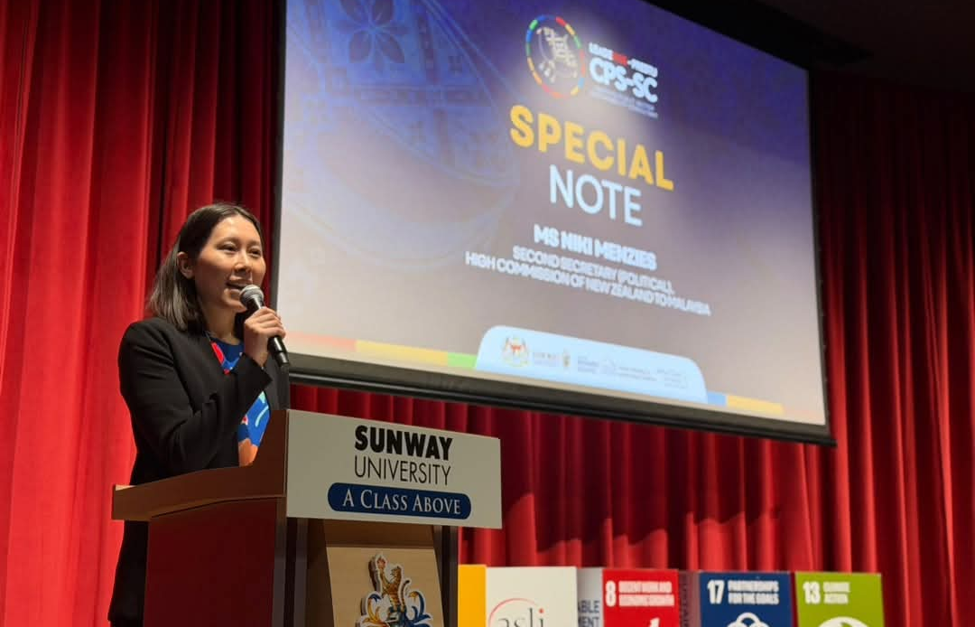
Family connection
Ms Niki Menzies
Second Secretary (Political)
High Commission of New Zealand to Malaysia
Daughter
Briefing the group on 14 September

Slide 4
Aotearoa new zealand: Key points
Long, thin country, a long way from most other places
Many physical risks, increasing with climate change
Relatively small population, highly urbanised
Creaking Infrastructure
A history of colonisation; strong indigenous culture
Ageing population, though not evenly
Uncertain geopolitical environment (not unique to NZ)
Three-year electoral cycle – short termism
Historically, economy based on primary sector; low productivity growth, many efforts to change

Slide 5
long term governance requires futures thinking
Not the same as planning (or even strategic foresight)
Malaysia has much to teach New Zealand about National Planning: Wawasan 2020; 13th Malaysia plan with core targets
Planning based on forecasts, projections (e.g. pensions)
Futures thinking: probable, possible and preferred futures
Not predictions, but scenarios
Asks “what if?”
Notes:
Not covering methods

Slide 6
The purpose of futures thinking
To identify key trends and uncertainties and probable, possible and preferred futures and their implications for the present, so that strategies, policies and plans can be made more anticipatory, adaptable and robust in the future that eventually emerges.
What if?

Slide 7
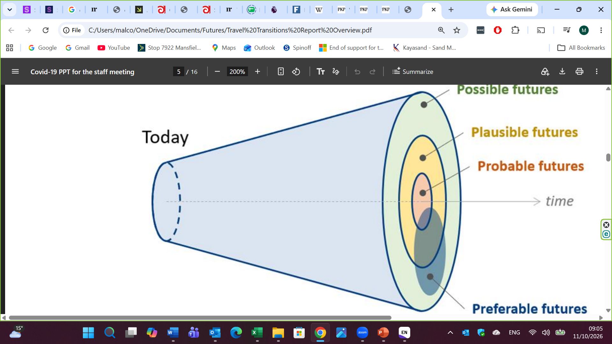
International transport forum

Slide 8
the history of long-term public governance in New Zealand
NZ Development Conferences
Planning Act 1977
Futures Trust
Central and local government initiatives
Knowledge Wave
Commissions for retirement, productivity, environment, infrastructure
Long Term Insights Briefings
Ad hoc bodies and interest groups

Slide 9
Nz Development Conferences
1960, 1968, 1972
To establish an agreed direction for diversifying the New Zealand economy away from its dependence on primary agricultural products (wool, butter, meat carcasses, etc.).
Farmers’ representative used his centre-stage opportunity to tell the exact opposite story to the one the government was trying to have heard: he claimed that if the farmers were only given enough resources, they could solve New Zealand’s economic problems all by themselves – i.e. by producing more of the same
Lesson: Vested interests will resist change

Slide 10
Planning Act 1977
Established the New Zealand Planning Council and the Commission for the Future.
The Commission was to study the possibilities for the long-term economic and social development of New Zealand, with particular reference to developments in science and technology and trends and events in New Zealand and overseas; to report to the minister and inform members of Parliament; and to publish and promote discussion and education about the future.
Scrapped in 1982 and 1990
Lessons: Read the political winds, don’t try to do too much

Slide 11
NZ futures trust
Non-governmental, membership-based body
Strong leader
Base gradually eroded
Became marginalised
Ran out of funds
Wound up in 2013
Archive at futuretimes.co.nz
Lessons: Resource base is essential (so is mandate)

Slide 12
The knowledge wave 2001
The Prime Minister and Chancellor of the University of Auckland co-chaired a conference to identify strategies for New Zealand’s transition into a knowledge society (echoes of the 1960s).
450 participants from political parties, the bureaucracy, academia, the business community, trade union movement, community organisations.
Very difficult to get consensus.
Mixed results; Gave rise to peak business organisations
Lessons: “big bang” events don’t work in the long term

Slide 13
Retirement Commission
Concerns about ageing population, how to support the baby boomers when they get old
Bitter disputes about pensions policy from the 1970s to the 1990s.
An accord was reached between political parties, including the establishment of the office of the Retirement Commissioner in 1993.
The Commission was expected to carry out periodic reviews of pensions policy (now every three years).
To “take the temperature” and to keep the temperature down!
Lesson: Independence is important, but not too much

Slide 14
Productivity Commission 2011-24
To provide independent advice and conduct in-depth inquiries to the government on ways to boost New Zealand’s productivity.
Government selected topics for inquiries; e.g. on housing affordability, international freight, economic relations with Australia, regulation
Acted as an advisory and research body rather than a policy-implementing agency, meaning the government was not legally bound to adopt its recommendations
Disestablished by incoming Government – funding diverted to a new Ministry for Regulation
Lesson: read the political winds; focus on core purpose; be prepared for tweaks

Slide 15
Commissioner for the Environment
Established in 1986. Produces independent reports and advice on environmental issues, and a mission to maintain or improve the quality of Aotearoa New Zealand’s environment.
Decisions to change environmental law, policy and institutional arrangements are the responsibility of Parliament, central government and local government. Implementing these decisions, and monitoring their impact on the environment, is the responsibility of government agencies.
Accountable to Parliament, not the Government of the day.
Lessons: Credibility and independence are of critical importance

Slide 16
Long Term Insights Briefings
2020 Legislative requirement requiring departmental chief executives to give a LTIB to the appropriate minister at least once every three years.
19 LTIBs prepared (too many, inconsistent approaches). Some more influential than others (Treasury). Policy Quarterly Boston, Jackson, Menzies
2026 Amendment requires the chief executive of the Department of the Prime Minister and Cabinet to give a LTIB to the Prime Minister and the Minister at least once in every 3-year period and independently of Ministers.
Will it work? Too soon to tell.
Lessons: Futures thinking is not well understood, nor supported. But there is hope!

Slide 17
Infrastructure Commission
Te Waihanga
Established in 2019. Researches important infrastructure issues, advises on policy, provides expert project support, and shares data on both upcoming projects and infrastructure performance.
The National Infrastructure Plan sets out a path for New Zealand’s infrastructure over the next 30 years.
Key insight: look after the infrastructure we have rather than just build new
Broadly accepted, though not guaranteed.
Successful because: Independent; cross party support, well resourced, clear purpose, focused; analytical, transparent. Very difficult to reject their findings.

Slide 18
Ad hoc bodies and interest groups
Aged care ministerial advisory group
Sets out a vision and a plan for supporting older people to live and age well through a new and better system of integrated aged care in this country – one where people can receive the right care, in the right place, at the right time.
New Zealand National Forum for the Decade of Healthy Ageing.
The choices Aotearoa New Zealand makes now will shape whether longer lives deliver a growing longevity dividend – the social and economic value created when people are able to age well for longer – or place increasing, avoidable pressure on health, housing, care and community systems.

Slide 19
what would it take to secure consistent political attention to the long term?
Political leadership that understands the importance of long-term governance, and supports futures thinking
Which means capability building
Plan initiatives at a high level, looking 30-40 years out, not enmeshed in the vested interests and politics of today
Don’t go for “big bangs”; aim for continuity
Be independent but politically savvy
Enlist credible voices, get cross-party support
Be focused, analytical, transparent.

